Slide 1

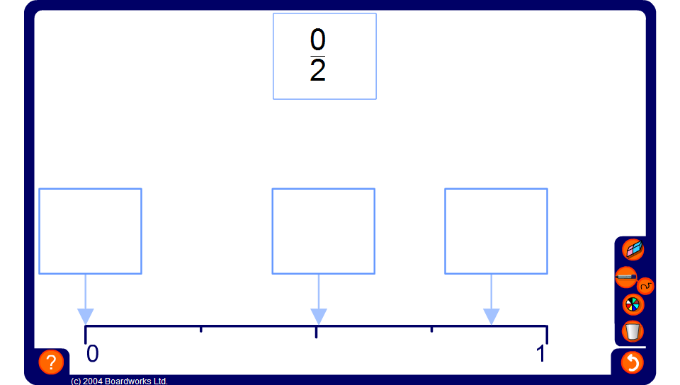


Fractions on a number line
Notes:
Ask volunteers to come to the board and drag the given fraction to the correct position on the number line.

